Slide 1
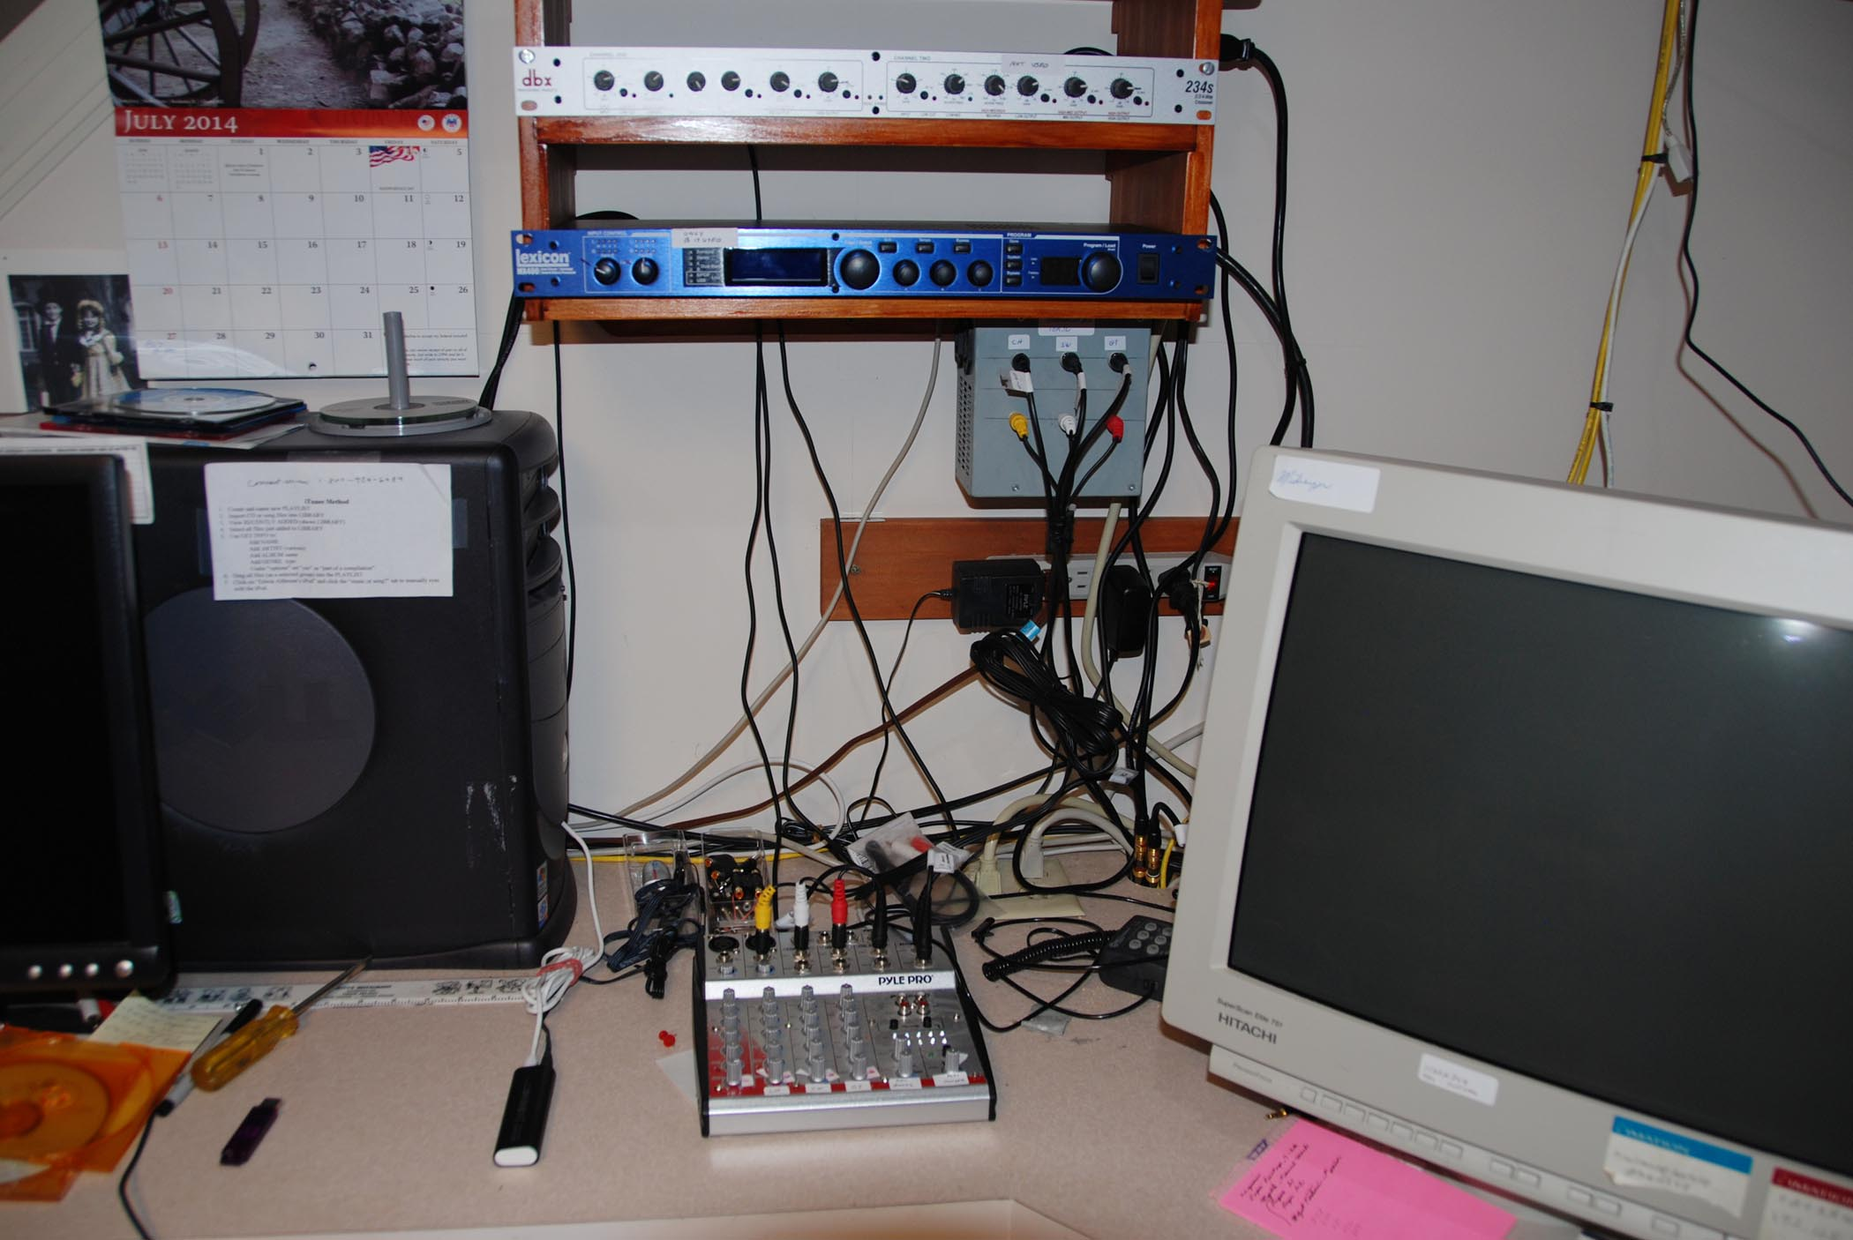
dbx electronic crossover for woofer to (midrange-Tweeter)
Lexicon MX400 reverberation unit
Resistive terminations to provide Impedance matching for the analog audio output of the 3 Soundblaster sound cards
Windows XP computer using Adobe Audition 1.5 for 2-channel digital recording (32-bit floating format)
Monitor for Windows XP computer that supports the organ software/firmware.
Pyle Pro analog mixer: combines the analog outputs of the 3 sound cards into two identical channels for final digital recording step

